Slide 1
BUDT 730 Data, Models and Decisions
Lecture 17
Time Series (2)
Prof. Sujin Kim

Slide 2
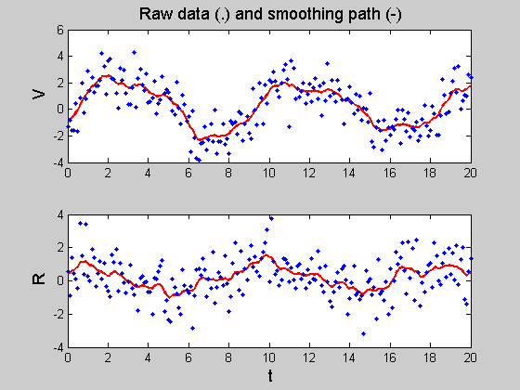

Smoothing-Based Methods for Time Series
0

Slide 3
Smoothing-Based Methods - Exponential Smoothing
Simple Exponential Smoothing
Holt’s Method (Double Exponential Smoothing)
Winter’s Method (Triple Exponential Smoothing)

Slide 4
Exponential Smoothing - Motivation
Regression model has the undesirable property that it treats the all observations equally.
Intuitively, past data should be discounted in a more gradual fashion
For example, the most recent observation should get a little more weight than 2nd most recent, and the 2nd most recent should get a little more weight than the 3rd most recent, and so on.
This is the motivation of exponential smoothing
Advantages: Simple, popular method for extrapolation.
Extrapolation model:
Use the past data of a time series variable and nothing else!
The goal is to extrapolate historical patterns into future

Slide 5
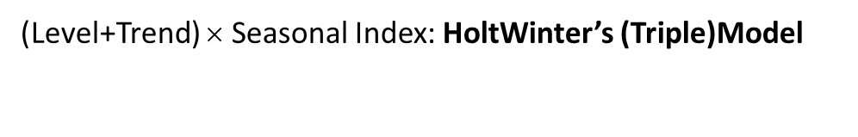
Types of Exponential Smoothing Models
(Level+Trend) × Seasonal Index: HoltWinter’s (Triple)Model
Sales
Seasonal Index
Level+Trend: Holt’s (Double) Model
Level: Simple Exponential Smoothing
Time

Slide 6
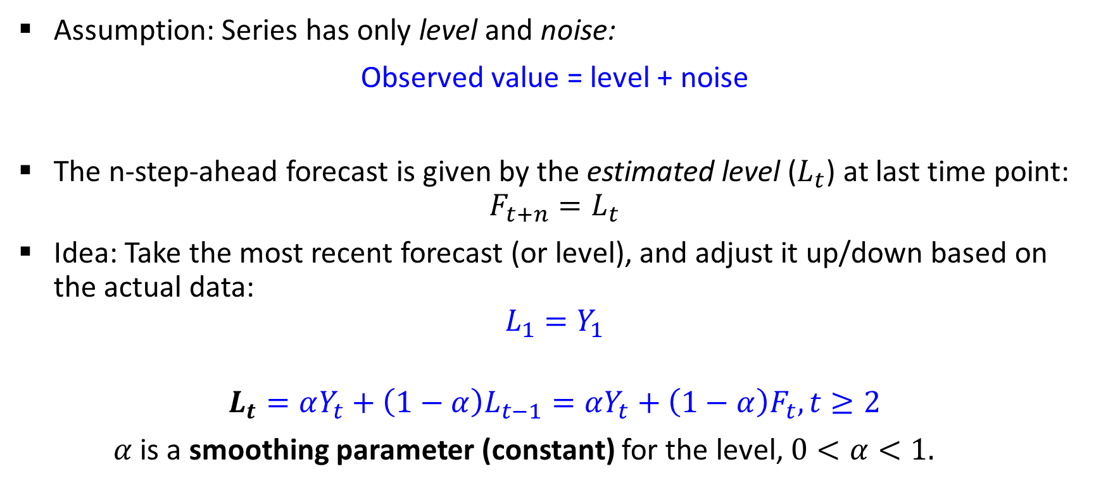
I. Simple Exponential Smoothing
0
Assumption: Series has only level and noise:
Observed value = level + noise
The n-step-ahead forecast is given by the estimated level ($L_{t}$) at last time point:
$$F_{t+n}=L_{t}$$
Idea: Take the most recent forecast (or level), and adjust it up/down based on the actual data:
$$L_{1}=Y_{1}$$
$$L_{t}=αY_{t}+\left(1−α\right)L_{t−1}=αY_{t}+\left(1−α\right)F_{t}, t≥2$$
$α$ is a smoothing parameter (constant) for the level, $0<α<1.$

Slide 7
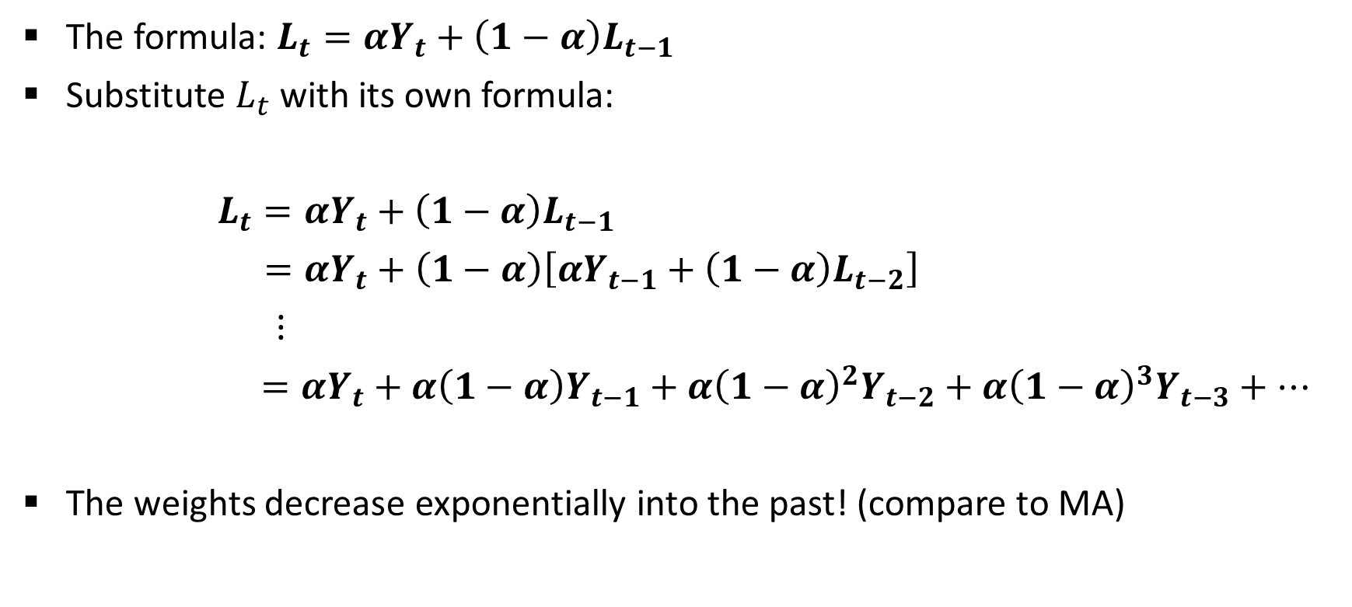
So why is it called “Exponential Smoothing”?
0
The formula: $L_{t}=αY_{t}+\left(1−α\right)L_{t−1}$
Substitute $L_{t}$ with its own formula:
$L_{t}=αY_{t}+\left(1−α\right)L_{t−1}$
$=αY_{t}+\left(1−α\right)\left[αY_{t−1}+\left(1−α\right)L_{t−2}\right]$
$⋮$
$=αY_{t}+α\left(1−α\right)Y_{t−1}+$ $α{\left(1−α\right)}^{2}Y_{t−2}+α{\left(1−α\right)}^{3}Y_{t−3}+…$
The weights decrease exponentially into the past! (compare to MA)

Slide 8
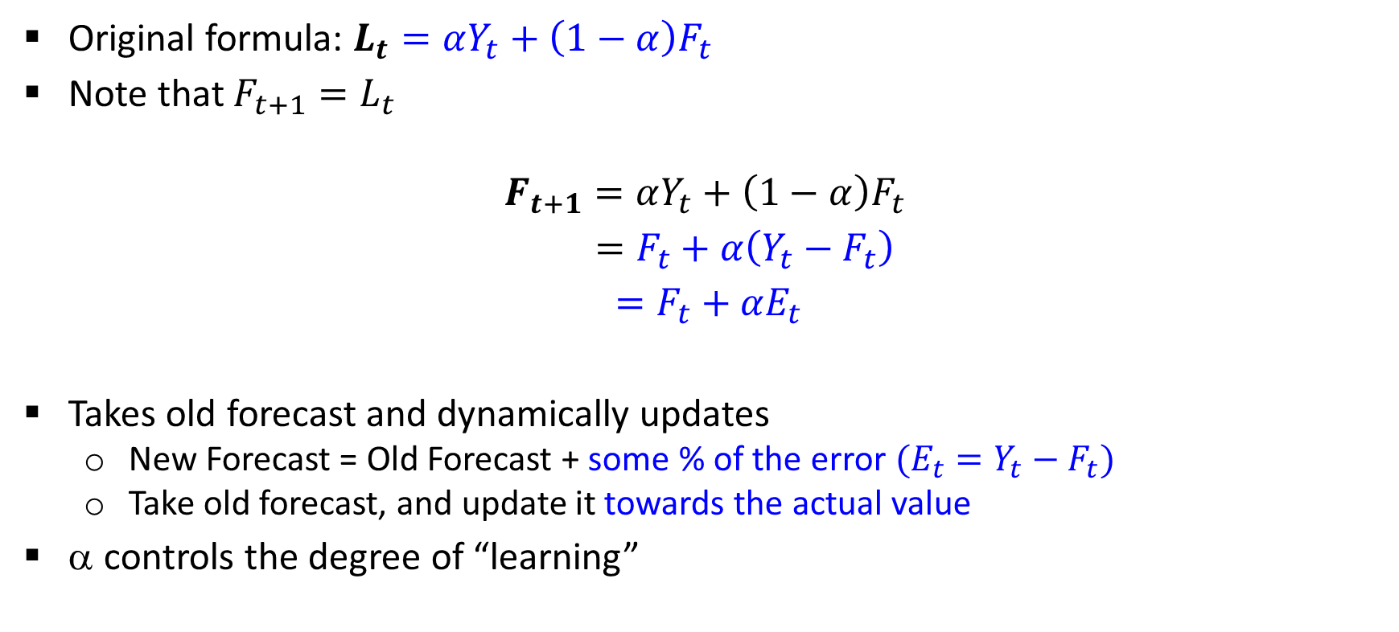
Another way of viewing it: An adaptive learning process
0
Original formula: $L_{t}=αY_{t}+\left(1−α\right)F_{t}$
Note that $F_{t+1}=L_{t}$
$$F_{t+1}=αY_{t}+\left(1−α\right)F_{t}$$
$=F_{t}+α\left(Y_{t}−F_{t}\right)$
$=F_{t}+αE_{t}$
Takes old forecast and dynamically updates
New Forecast = Old Forecast + some % of the error $(E_{t}=Y_{t}−F_{t})$
Take old forecast, and update it towards the actual value
α controls the degree of “learning”

Slide 9
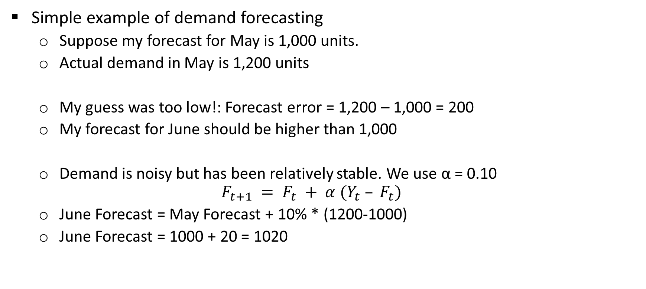
Simple Exponential Smoothing Example
Simple example of demand forecasting
Suppose my forecast for May is 1,000 units.
Actual demand in May is 1,200 units
My guess was too low!: Forecast error = 1,200 – 1,000 = 200
My forecast for June should be higher than 1,000
Demand is noisy but has been relatively stable. We use α = 0.10
$$F_{t+1} = F_{t} + α (Y_{t} – F_{t})$$
June Forecast = May Forecast + 10% * (1200-1000)
June Forecast = 1000 + 20 = 1020

Slide 10








Smoothing Parameter α
The large value of smoothing parameter implies that the model more aggressively incorporates new information.
$$F_{t+1}=F_{t}+α\left(Y_{t}−F_{t}\right)$$
α = 1: past observations have no influence over forecasts. Under-smoothing.
α $≈$ 0 : past observations have large influence on forecasts. Over-smoothing.
$$F_{t+1}=F_{t}+α(Y_{t}−F_{t})$$
Sales
$$Y_{t}$$
$$α=1\text{: }F_{t+1}=Y_{t}$$
$$α=\text{0.5}\text{: }F_{t+1}=0.5F_{t}+0.5Y_{t}$$
$$F_{t}$$
$$α=\text{0}\text{: }F_{t+1}=F_{t}=F_{t−1}=…=F_{2}=L_{1}=Y_{1}$$
$$t$$
$$t+1$$
Time
Notes:
= 1: undersmoothing, overfitting
$≈$ 0 : οϖερσμοοτηινγ, υνδερφιττινγ

Slide 11
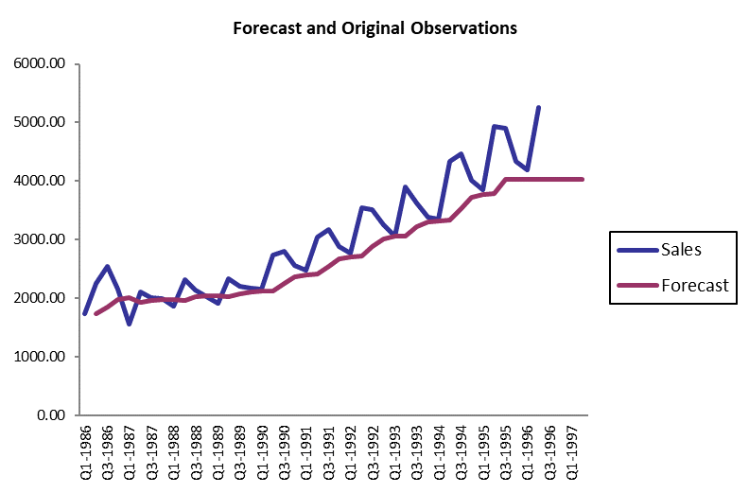
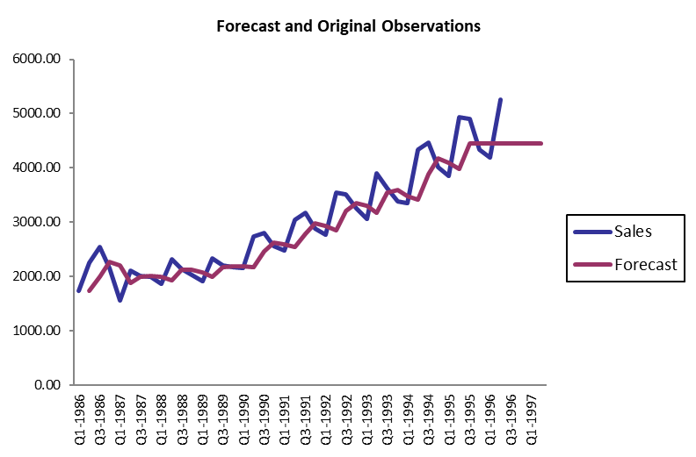
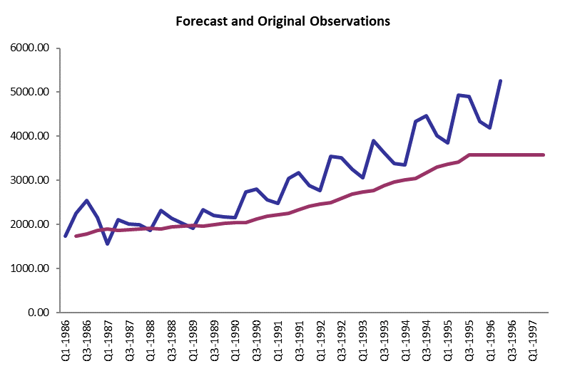


Choosing $α$
0
Balance (too small – too large)
$α$=0.01 (underfitting, over-smoothing) $α$=0.1 $α$=0.5 (overfitting, under-smoothing)

Slide 12
Smoothing Parameter α
0
Selecting α
“Typical” values: 0.1, 0.2
Trial & error: effect on visualization
Value that minimizes RMSE or MAPE of training data – danger of overfitting
“Prediction is very difficult, especially if it's about the future.”
-Nils Bohr, Nobel laureate in Physics
It's often easy to find a model that fits the past data well
But, our goal is to find a model that correctly identifies patterns in the past data that will continue to hold in the future
Notes:
This quote serves as a warning of the importance of validating a forecasting model out-of-sample. It's often easy to find a model that fits the past data well--perhaps too well!--but quite another matter to find a model that correctly identifies those patterns in the past data that will continue to hold in the future.

Slide 13
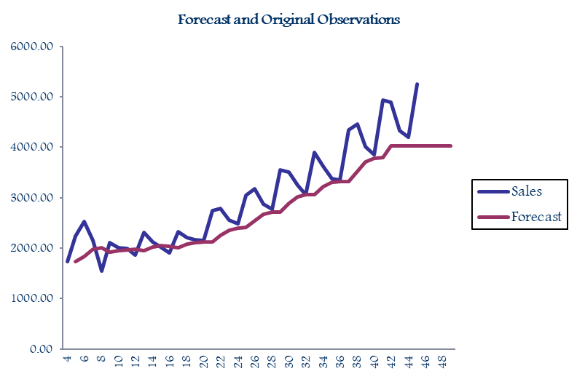
Example: Coca Cola Sales
0
𝛼 =0.1:
The fitted values are lagged

Slide 14

II. Holt’s Method (Double exponential smoothing)
0
Idea: Series has level, trend and noise:
Observed demand = level + trend + noise
The n-step-ahead forecast is given by combining the level $\left(L_{t}\right)$and the trend $\left(T_{t} \right)$ estimate at time $t :$
$$F_{t+n}=L_{t}+nT_{t}$$
Notes:
Interpretation of T_t : same as b_T in regression based model

Slide 15
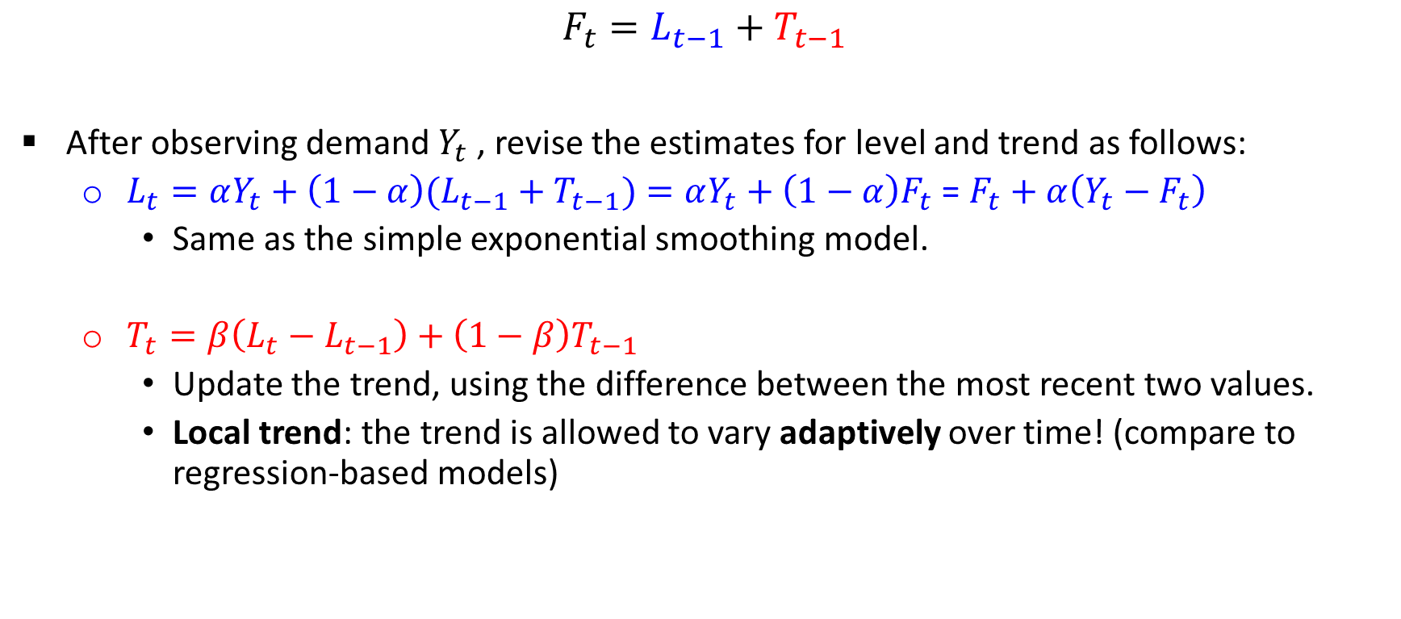
Updating Level and Trend
$$F_{t}=L_{t−1}+T_{t−1}$$
After observing demand $Y_{t}$, revise the estimates for level and trend as follows:
$L_{t}=αY_{t}+\left(1−α\right)(L_{t−1}+T_{t−1})=αY_{t}+\left(1−α\right)F_{t}$ = $F_{t}+α\left(Y_{t}−F_{t}\right)$
Same as the simple exponential smoothing model.
$T_{t}=β\left(L_{t}−L_{t−1}\right)+\left(1−β\right)T_{t−1}$
Update the trend, using the difference between the most recent two values.
Local trend: the trend is allowed to vary adaptively over time! (compare to regression-based models)

Slide 16
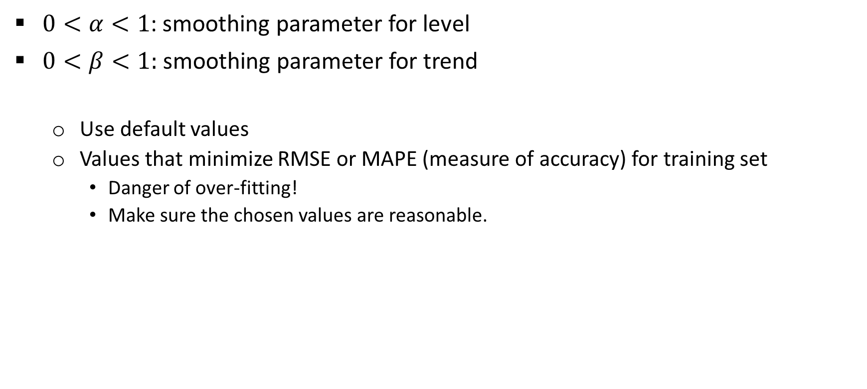
Choosing α and β
0
$0<α<1$: smoothing parameter for level
$0<β<1:$ smoothing parameter for trend
Use default values
Values that minimize RMSE or MAPE (measure of accuracy) for training set
Danger of over-fitting!
Make sure the chosen values are reasonable.

Slide 17
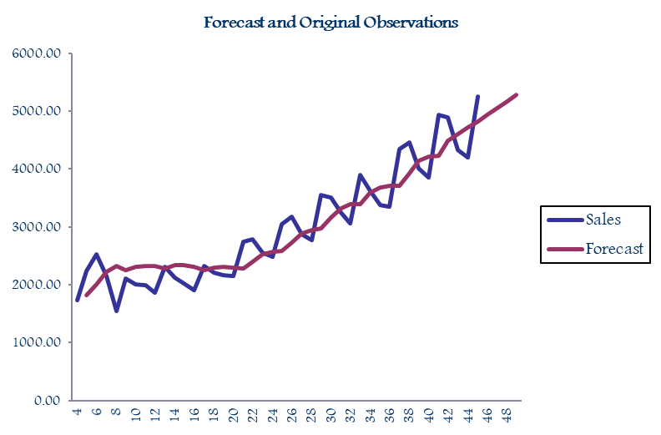
Output for Holt’s Method (Double Exponential)
0
No lag

Slide 18
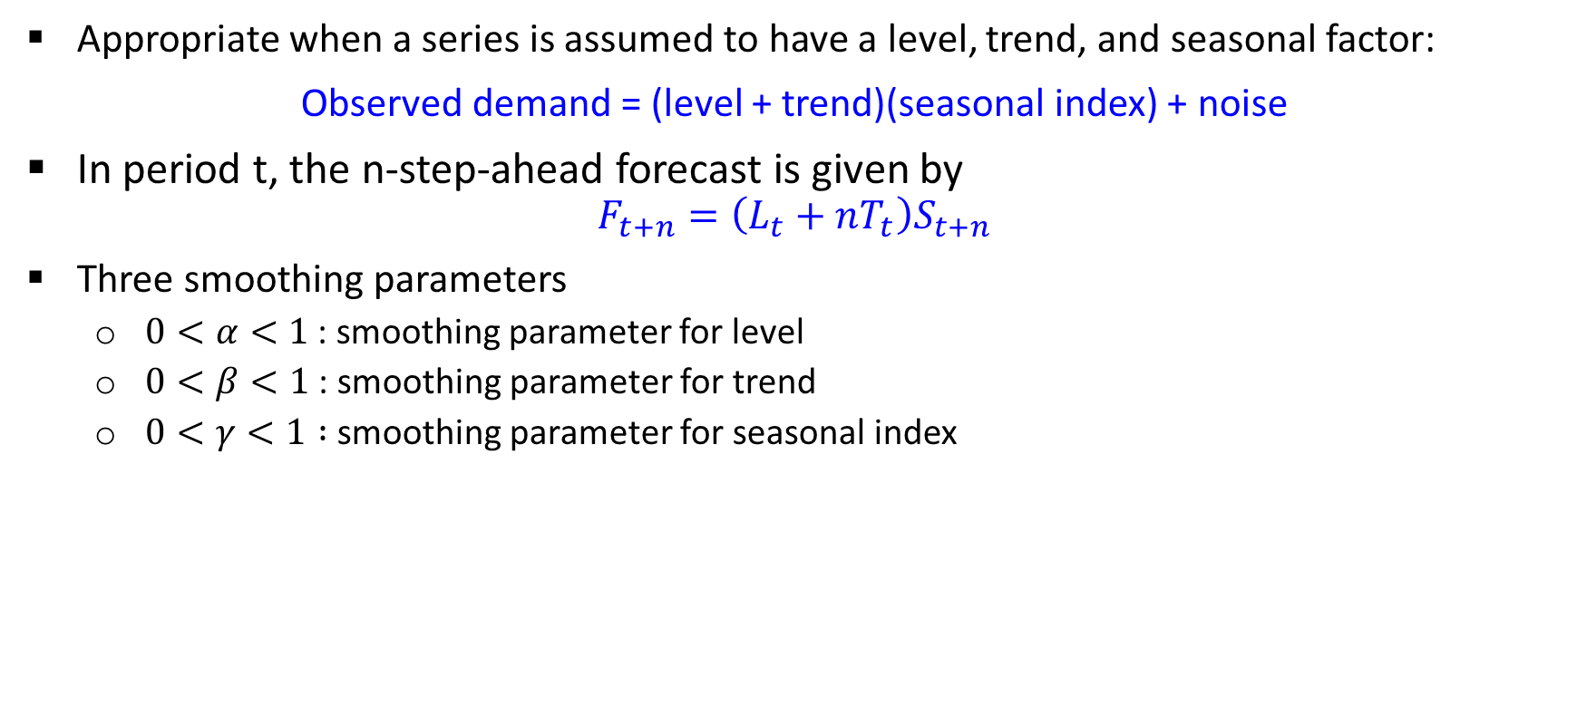
III. Holt-Winter’s Method (Winter or Triple Exponential Smoothing)
Appropriate when a series is assumed to have a level, trend, and seasonal factor:
Observed demand = (level + trend)(seasonal index) + noise
In period t, the n-step-ahead forecast is given by
$$F_{t+n}=\left(L_{t}+nT_{t}\right)S_{t+n}$$
Three smoothing parameters
$0<α<1$ : smoothing parameter for level
$0<β<1$ : smoothing parameter for trend
$0<γ<1 :$smoothing parameter for seasonal index

Slide 19
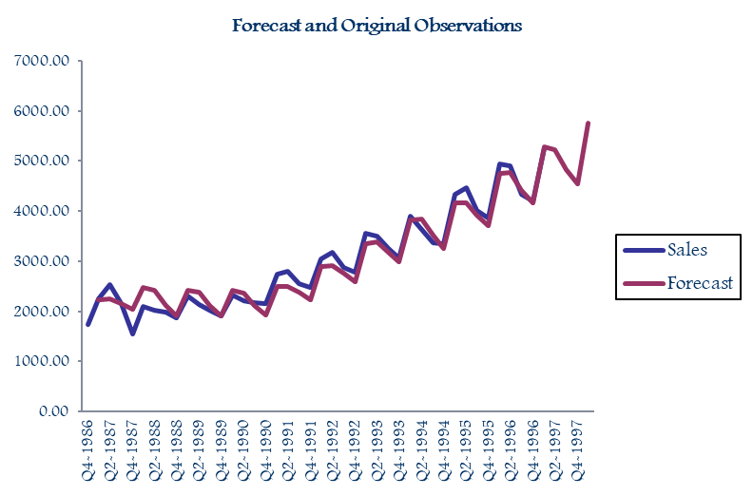
Output for Holt-Winter’s Method
0

Slide 20
Practice – Exponential Smoothing
Data: Coca_Cola_Data.xlsx

Slide 21
R packages and functions
Package ‘Metrics’ : to compute RMSE and MAPE.
Package ‘forecast’ to generate forecasts
Functions:
ts(): store the data in a time series object
window(): extracts the subset of the object observed between the times start and end.
HoltWinters(): Computes Holt-Winters Filtering of a given time series. Unknown parameters are determined by minimizing the squared prediction error.
forecast(): forecast from time series or time series models

Slide 22
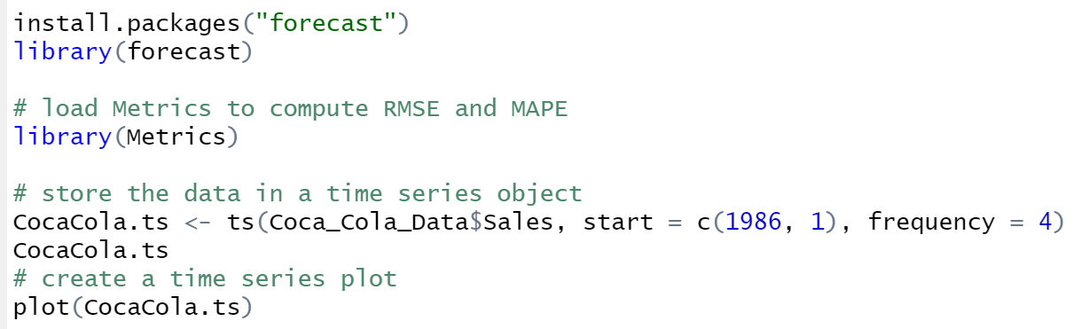
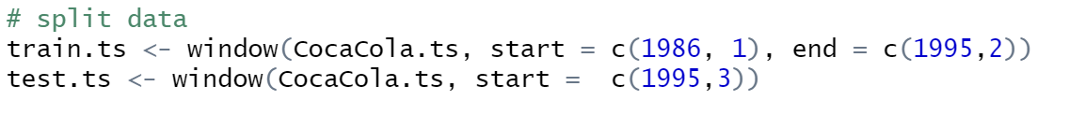

Slide 23
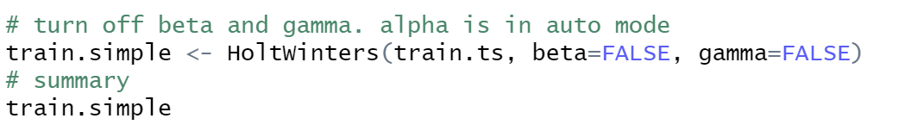
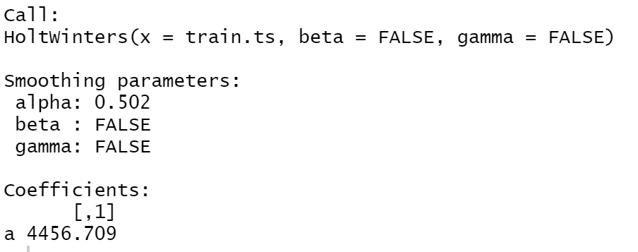
Simple Exponential Smoothing Model

Slide 24
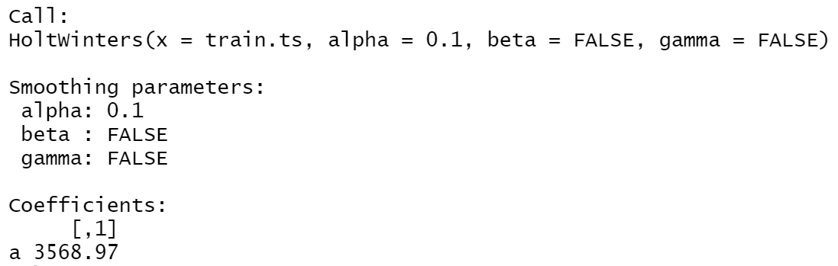
Simple Exponential Smoothing Model

Slide 25
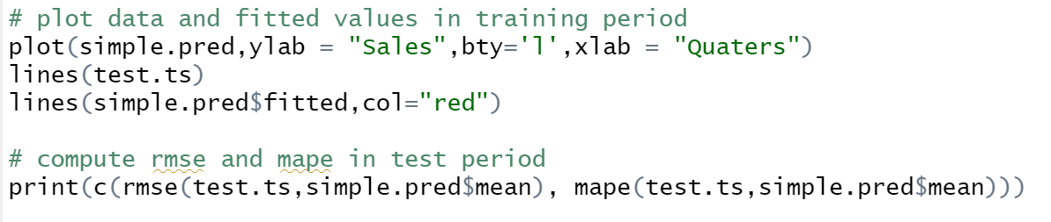
Simple Exponential Smoothing Model Version 1 (with forecast function)

Slide 26
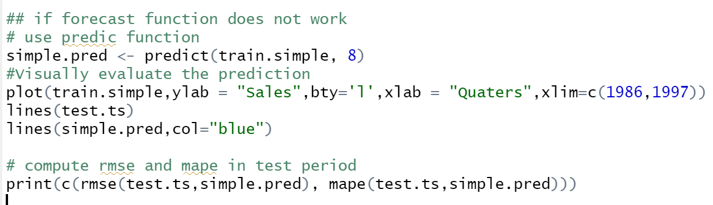
Simple Exponential Smoothing Model Version 2 (with predict function)

Slide 27
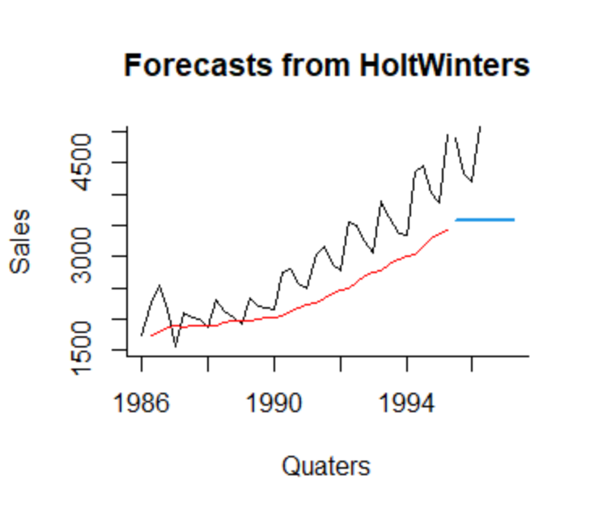
Simple Exponential Smoothing Model
Simple Exponential Smoothing
RMSE | 1179.91
MAPE | 22.92%

Slide 28
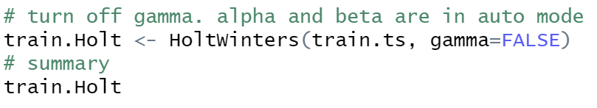
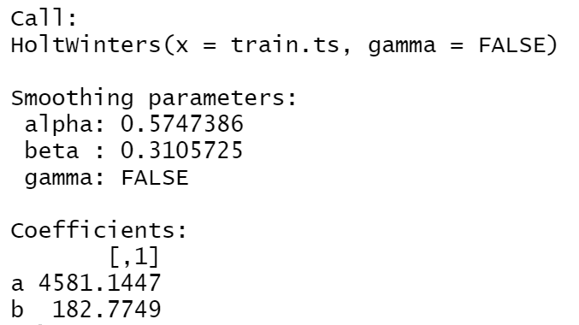
Holt’s (Double) Exponential Smoothing Model

Slide 29
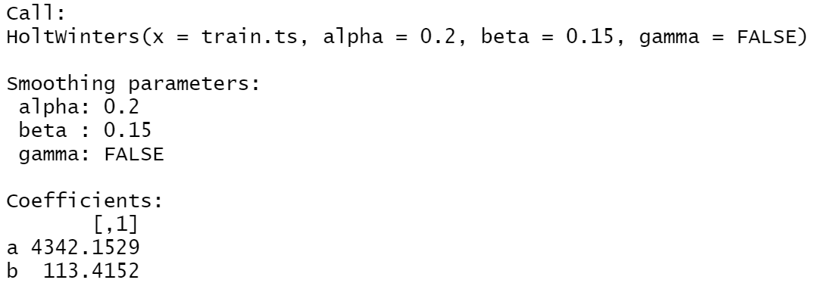
Holt’s (Double) Exponential Smoothing Model

Slide 30
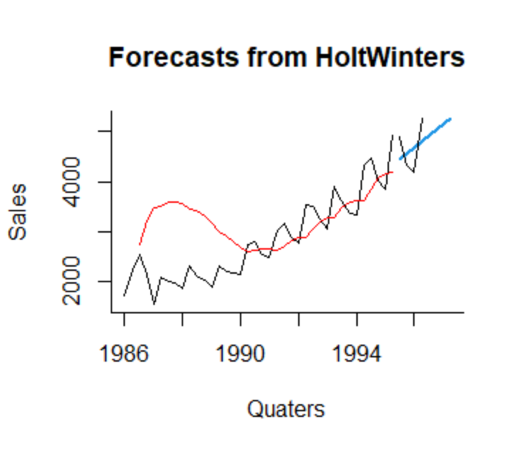
Holt’s (Double) Exponential Smoothing Model
Simple Exponential Smoothing
RMSE | 1179.91
MAPE | 22.92%
Holt’s Model
RMSE | 417.24
MAPE | 8.69%

Slide 31
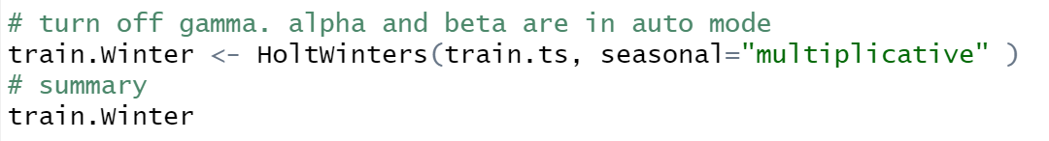
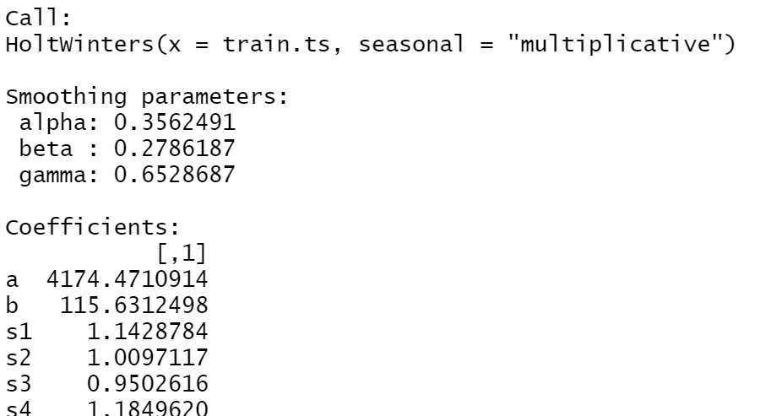
Holt-Winter’s (Winter or Triple) Exponential Smoothing Model

Slide 32
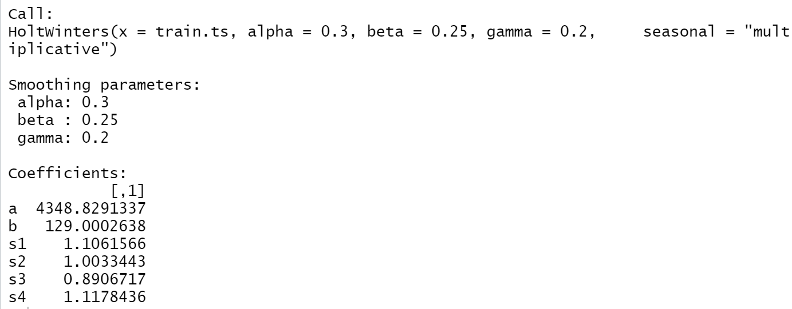
Holt-Winter’s (Winter or Triple) Exponential Smoothing Model

Slide 33
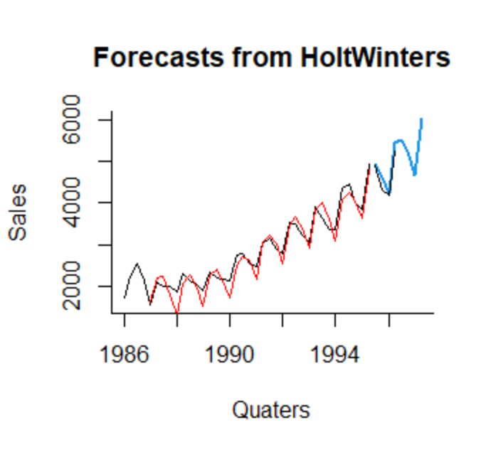
Holt-Winter’s (Winter or Triple) Exponential Smoothing Model
Holt’s Model
RMSE | 417.24
MAPE | 8.69%
Holt-Winter’s Model
RMSE | 143.45
MAPE | 2.47%

Slide 34
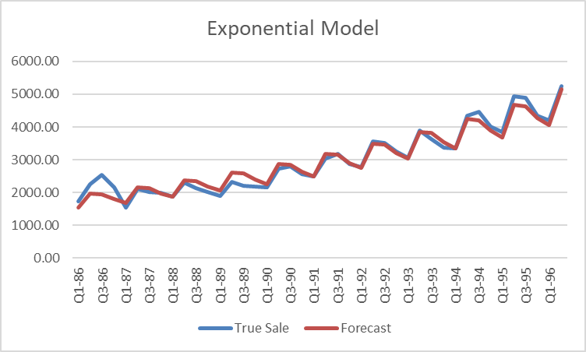
Coca Cola Sales - Comparisons
 | Exponential Regression | Winter’s
RMSE | 225.52 | 143.45
MAPE | 4.47% | 2.47%

Slide 35
Exponential Smoothing Method - Summary
0
Adaptive Method:
Weights are adaptively adjusted over time
Simple Extrapolation Method: easy to understand
Large smoothing parameter value – aggressively incorporated new information
When smoothing constants are selected to minimize measure of accuracy on training set, beware of over-fitting!
“Judgmental adjustments” are common in practice.

Slide 36
Other Examples & Summary

Slide 37
Summary of methods
Method | level | trend | seasonality | comment
Simple exponentioal smoothing | V
Double (Holt's) exponential smoothing | V | V
Triple (Holt-Winter's) exponential smoothing | V | V | V
Regression | V | V | V | Assumes stationarity
All methods are adaptive except regression based models.

Slide 38
Example: Miles traveled
Which of the components seem to be present in this series?
Trend / Seasonality / Level / Noise / Other ?
Which of the following methods would be suitable for fitting the training data?
Simple exponential smoothing
Double (Holt’s) exponential smoothing
Triple (Winter’s) exponential smoothing
Regression-based model
Notes:
2,5,6

Slide 39
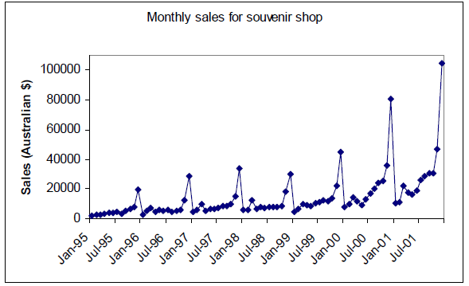
Example: Sales
Which of the components seem to be present in this series?
Trend / Seasonality / Level / Noise / Other ?
Which of the following methods would be suitable for fitting the training data?
Simple exponential smoothing
Double (Holt’s) exponential smoothing
Triple (Winter’s) exponential smoothing
Regression-based model
Notes:
2,5

Slide 40
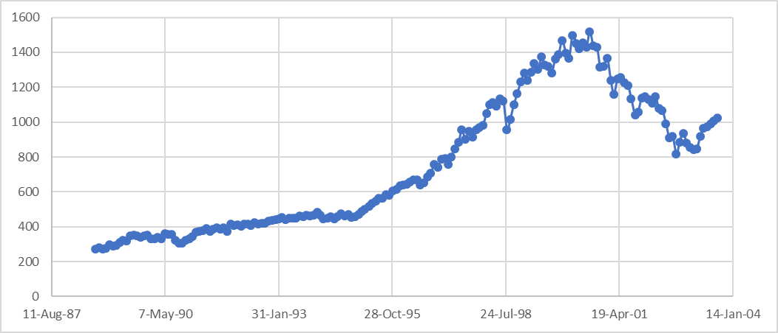
Example: S&P 500
Which of the components seem to be present in this series?
Trend / Seasonality / Level / Noise / Other ?
Which of the following methods would be suitable for fitting the training data?
Simple exponential smoothing
Double (Holt’s) exponential smoothing
Triple (Winter’s) exponential smoothing
Regression-based model
Notes:
1,3,4

Slide 41
Next …
Ch6 Decision Tree

